Slide 1



SENIOR
DESIGN
PROJECT
TITLE:
WATER
FOR SUSTAINABILITY
AND
STOCKS
By Subrahmanya H and Robin Kori

Slide 2
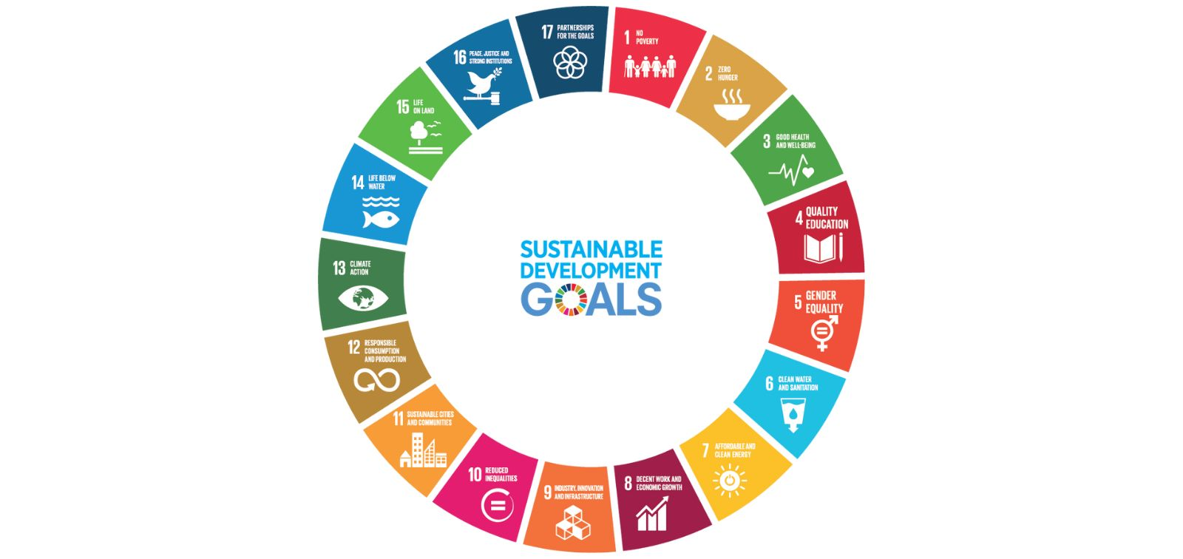
Focuses on ensuring access to safe water and sanitation while promoting efficient water use and protecting freshwater resources.
SDG 6
Advocates for inclusive economic development by fostering innovation, sustainable livelihoods, and fair employment opportunities.
SDG 8
Encourages protection of marine ecosystems through sustainable practices that reduce pollution, conserve biodiversity, and support ocean health. SDG 14

Slide 3
Introduction
We are working on the project “Water for Sustainability and Stocks”, focusing on the intersection of finance and sustainability.
This project integrates three Sustainable Development Goals (SDGs):
  SDG 6: Clean Water and Sanitation
  SDG 8: Decent Work and Economic Growth
  SDG 14: Life Below Water
Our aim is to:
  Analyze water footprints across countries and companies.
  Study company-level water consumption and its role in sustainability.
  Develop a sustainable stock manager that links water usage efficiency with stock performance.
By combining environmental data with financial models, we demonstrate how sustainability directly influences economic growth and stock markets.

Slide 4
Problem Statement
We are have created the project with unified framework that integrates water sustainability indices (WSI) with stock performance analysis to address ecological impact, clean water availability, and economic growth simultaneously. This project aims to bridge this gap by creating a model that aligns with SDG 6, SDG 8, and SDG 14, enabling sustainable decision-making for industries, investors, and policymakers.
The Project Covers below Points
Current stock market models do not integrate sustainability factors like water footprint into company evaluation.
Overuse of freshwater resources for industrial and beverage production threatens both ecosystems and human needs.
There is a lack of unified frameworks that link water sustainability, economic growth, and stock performance in line with SDG 6, SDG 8, and SDG 14.

Slide 5

Literature Survey
SL No | Paper Title & Authors (Year) | Summary | SDG Impact | Limitations
1 | Value-transforming Financial, Carbon and Biodiversity Footprint Accounting — S. El Geneidy et al. (2023) (arXiv) | Proposes a framework to integrate financial accounting with environmental footprints—including water, carbon, and biodiversity—demonstrated using a university “living lab.” | SDG 6, SDG 15, SDG 13 — Presents a holistic environmental-financial accounting model. | Conceptual framework; limited real-world corporate application.
2 | Water Disclosure And Financial Performance: The Case Of CDP Water A-List Companies — Inaliah Mohd Ali et al. (2020) (European Proceedings) | Examines CDP Water A-List companies and finds a positive correlation between water disclosure practices and increased earnings per share (EPS) and share prices. | SDG 6, SDG 8 — Links water transparency to financial outcomes in companies. | Sample limited to CDP-listed firms; causality not established.
3 | Industrial Water Footprint Assessment: Methodologies in Need of Improvement — Boulay, Pfister et al. (2014) (ACS Publications) | Reviews flaws in water footprint methodologies when applied to industrial sectors, especially highlighting the need to improve blue/grey water accounting and supply-chain coverage. | SDG 6 — Strengthens methodological rigor in industrial water use assessments. | Academic/approach-focused; lacks real-world datasets.
4 | Cost and Water Footprint Trade-off in a Supply Chain Optimization Model — Dennis E Cruz & Raymond R Tan (2023) (PMC) | Develops a bi-objective optimization model to minimize both cost and water footprint in supplier selection for water-intensive industries. | SDG 6, SDG 8 – Integrates sustainable water use in supply chains with economic decision-making. | Context-specific modeling; not tested with real corporate data.
5 | National Water Footprint Accounts: The Green, Blue and Grey Water Footprint of Production and Consumption —Hoekstra, A.Y. & Mekonnen, M.M. (2011, expanded 2012 PNAS) | Proposed the first global water footprint framework, distinguishing green, blue, and grey water. Quantified national footprints and showed how trade shifts water use across borders. | SDG 6 (Clean Water & Sanitation), SDG 12 (Responsible Consumption & Production), SDG 14 (Life Below Water) | Early methodology—did not fully account for regional water scarcity, sustainability thresholds, or uncertainty. Strong on global/national scale but less precise at company.

Slide 6
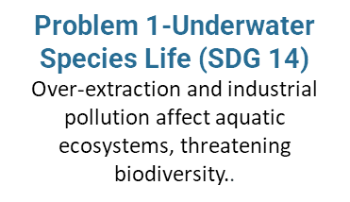
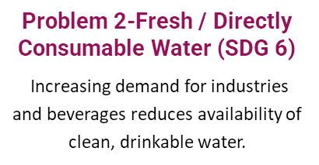
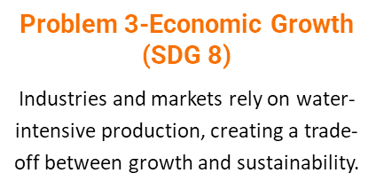
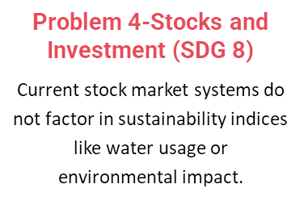
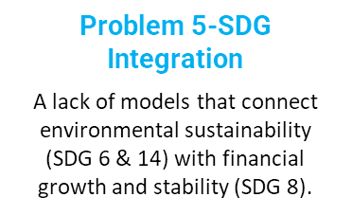
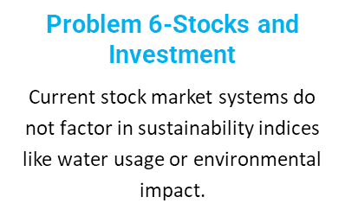
Problem Formulation

Slide 7
Motivation
Water as a critical resource: Freshwater scarcity is rising, and industries must align with sustainable practices.
Bridging sustainability and finance: Investors increasingly demand ESG-linked (Environmental, Social, Governance) insights, but water use is often overlooked.
SDG integration: Linking SDG 6, SDG 8, and SDG 14 provides a holistic approach to sustainability and economic growth.
Practical impact: A sustainability-driven stock manager can guide industries, investors, and policymakers toward more responsible decisions.

Slide 8
Objectives
  Promote sustainable practices aligned with SDG 14 (Life Below Water), SDG 6 (Clean Water and Sanitation), and SDG 8 (Decent Work and Economic Growth).
  Develop scalable models that address water conservation, marine pollution reduction, and eco-friendly employment opportunities.
  Empower youth and local communities through awareness campaigns, data-driven insights, and participatory design.

Slide 9
Engineering Principles
  Sustainability & Lifecycle Thinking: Design solutions that minimize environmental impact across their lifespan.
  Systems Engineering: Integrate interdisciplinary approaches to address water, marine, and economic challenges holistically.
  Optimization & Simulation: Use data modeling to evaluate resource efficiency, pollution control, and employment scalability.
  Human-Centered Design: Prioritize accessibility, inclusivity, and community feedback in solution development.

Slide 10
Problem Analysis
Fragmented Water Footprint Data
Global water usage metrics vary widely across countries, making it difficult to assess marine impact and align with SDG 14 without standardized preprocessing.
Lack of Transparency in Corporate Sustainability
Company-level water consumption and sustainability efforts are often underreported or inconsistent, posing challenges for meaningful evaluation under SDG 6.
Sales-Driven Decisions Over Sustainability
Business growth metrics like sales often overshadow environmental considerations, limiting progress towards SDG 8 unless integrated into predictive models.
Global Water Footprint Collection
Preprocessing
Company Dataset Collection
Impact Modeling
Custom Dataset Creation
Sales Data Integration
Monte Carlo Stock Calculator Implementation
Factor Assignment

Slide 11
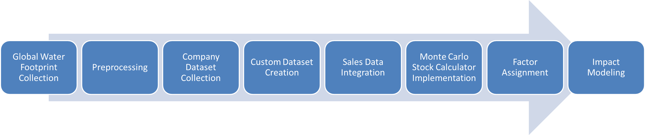
Problem Analysis
Uncertainty in Real-World Impact
External factors—market volatility, policy shifts, and randomness—affect outcomes unpredictably, requiring probabilistic tools like Monte Carlo simulations to model realistic scenarios.
Disconnected Data Streams
Global footprint, company metrics, and sales data are rarely analyzed together, missing the opportunity to create holistic sustainability models that influence all three SDGs.
Need for Weighted Decision Frameworks
Without assigning meaningful weights to country WSI, company footprint, sales, and luck, sustainability modeling lacks actionable precision and fails to guide ethical growth.

Slide 12
Overall Communication
  Unified Sustainability Model
  Integrates water footprint, corporate responsibility, and economic growth in alignment with SDGs.
  Data-Driven Insights
  Uses weighted inputs and simulations to enable informed, ethical, and actionable decision-making.
  Real World Impact
  Translates raw data into strategies that guide stakeholders toward measurable sustainability outcomes.
Global Water Footprint Collection
Preprocessing
Company Dataset Collection
Impact Modeling
Custom Dataset Creation
Sales Data Integration
Monte Carlo Stock Calculator Implementation
Factor Assignment

Slide 13
Implementation
  Key Steps in System Implementation
  Data Integration:
    Combined Global Water Footprint Dataset and Company Water Consumption Dataset for multi-level sustainability analysis.
  Preprocessing:
    Normalizing water footprint values.
    Encoding country-level
    Water Sustainability Index (WSI).
  Cleaning and scaling sales/market volume data.
  Design Principles Used:
    Sustainability-Driven Modeling – environmentally weighted financialanalysis.
    Systems Engineering – connecting geography, industry, and finance.
    Probabilistic Simulation – representing market uncertaintyrealistically.
  Outcome: Clean, integrated dataset ready for simulation and stock projection models.

Slide 14
Implementation
  Monte Carlo Simulation Model
  Simulates stock price evolution for 252 trading days.
  Core formula (Geometric Brownian Motion):
  Pt+1 = Pt · e(μ−0.5σ2)+σZ
  Drift μ influenced by:
    Sustainability Score
    Country WSI Impact
    Company Water Footprint
    Random component Z (luck factor)models market volatility.
  Model Comparison
    Baseline Model – uses only sales volume.
    Sustainability-Enhanced Model – adds WSI + company footprint.
    Monte Carlo Model – adds randomness, making results more realistic.

Slide 15
Comparison
Feature / Criterion | Monte Carlo Simulation | Markov Chain Simulation | ARIMA Time-Series Forecasting | LSTM / Deep Learning Models | Agent-Based Simulation | System Dynamics (SD)
Approach Type | Stochastic probabilistic simulation | Probabilistic state-transition model | Deterministic statistical model | Deep learning neural network | Individual agent interaction model | Feedback-loop, system-level modeling
Uses Randomness? | ✔ Yes | ✔ Yes (state transition) | ✖ No (predictive trend) | ✔ Yes (learns noisy patterns) | ✔ Yes (random behavior possible) | ✖ No (deterministic unless noise added)
Data Requirement | Very low | Low | High (historical series needed) | Very high (large time-series datasets) | High (define rules for many agents) | Medium
Handles Uncertainty & Volatility | ⭐ Excellent | Moderate | Poor (only trends) | Moderate | High | Low (unless stochastic extensions used)
Captures Market Randomness | ⭐ Best suited | Limited | ✖ No | Moderate | High but unrealistic for stock prices | Not designed for randomness
Input Dependency | Few parameters (drift, volatility, factors) | Transition matrix | Historical stock time-series | Large labeled data | Rules & agent behavior logic | System equations & flows
Interpretability | ⭐ Very high | High | High | Low (black-box) | Moderate | High
Computation Cost | Low | Low | Low | Very High (GPU recommended) | High | Moderate
Ideal Use Cases | Stock simulation, risk modeling, finance | Weather modeling, machine states | Sales forecasting, economic trends | Long-term stock price prediction (with history) | Crowd behavior, disease spread | Policy modeling, environmental flow dynamics
Strengths | Simple, flexible, handles randomness | Models transitions well | Good for seasonal/linear patterns | Learns complex non-linear patterns | Realistic behavior modeling | Excellent for feedback-based systems
Weaknesses | No learning | Not suitable for continuous stock prices | Fails when sudden shocks occur | Needs huge datasets | Overly complex for stock simulation | Not focused on randomness
Suitability for Your Project | ⭐ Excellent | Low | Very Low | Low | Very Low | Very Low

Slide 16
Comparison
Model | Summary
Monte Carlo | Best for your project — models randomness, risk, volatility, and multi-factor influence.
Markov Chain | Good for state transitions, not suitable for continuous stock price simulation.
ARIMA | Needs historical data; poor at modeling uncertainty.
LSTM | Powerful but requires huge datasets; black-box.
Agent-Based | Overkill; models behavior of many agents, not needed here.
System Dynamics | Feedback-loop modeling, not suited for stochastic financial simulation.

Slide 17
Colab: Implementation
Full Implementation Code Available At:
Link

Slide 18
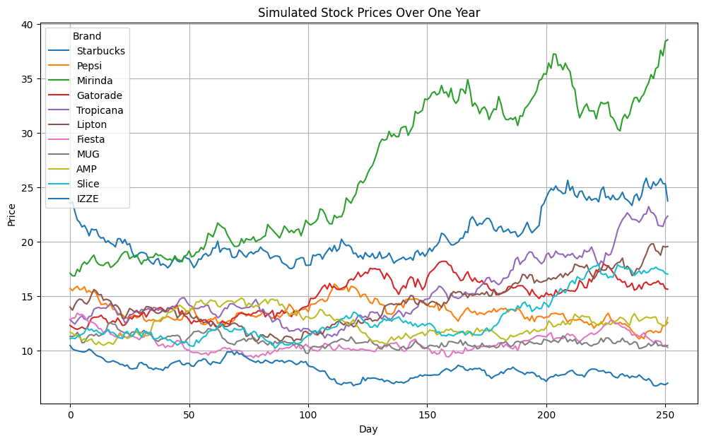
Results and Analysis
  Starbucks has highest sustainability score and stable stock projection.
  Pepsi shows volatility due to regional water stress.
  Countries like USA and Russia show high industrial footprint → lowerWSI.
  Simulation demonstrates sustainability–finance correlation.

Slide 19
Future Scope
  Building IPO apps based on the WSI stock Strategy helps for companies
  Integrate real-time financial APIs.
  Add ESG and climate risk datasets.
  Use Reinforcement Learning for dynamic stock strategy.
  Build portfolio-wide sustainability analysis.
  Mobile app for stock sustainability prediction.

Slide 20
References
  Water Footprint Network – Dataset (National Water Footprint Accounts: The Green, Blue and Grey Water Footprint of Production and Consumption —Hoekstra, A.Y. & Mekonnen, M.M. (2011, expanded 2012 PNAS)
  FAO Aquastat
  Monte Carlo Simulation Theory (GBM)
  Python Libraries: Pandas, NumPy, Matplotlib

Slide 21


THANK YOU

